Slide 1

COMPUTER NETWORKS
(BCSC 0008)
Copyright content, use only with the written permission of presenter mentioned
Lecture 21

Slide 2
Text and Reference Books
Text Books:
Fourouzan B. A. (2004), “Data Communication and Networking”, 4th Edition, McGraw-Hill.
References:
Kurose, J. F. and Ross K. W. (2005), “Computer Networking: A Top-Down Approach Featuring the Internet”, 3rd Edition, Addison-Wesley.
A. S. Tanenbaum (2006), “Computer Networks”, 2nd Edition, Prentice Hall India.

Slide 3
Basics
The IPv4 addresses are unique and universal.
An IPv4 address is 32 bits long.
The address space of IPv4 is 2³² (4,294,967,296)
32 bit address is divided into 4 octet ( also known as byte)
To connect on internet each device requires a unique IP address

Slide 4
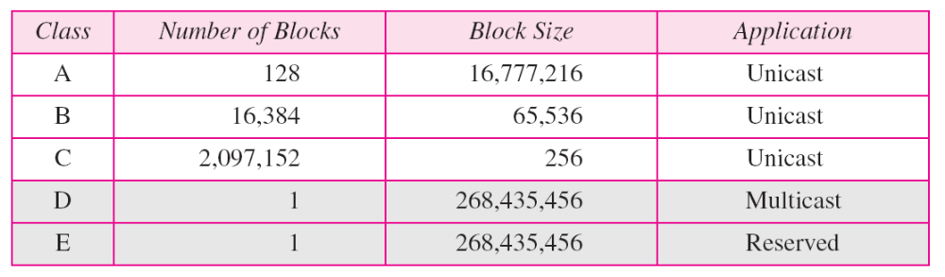
Classes and Blocks
The classful addressing wastes a large part of the address space.
  Class A:
  Class B:
  Class C:
  Class D:

Slide 5
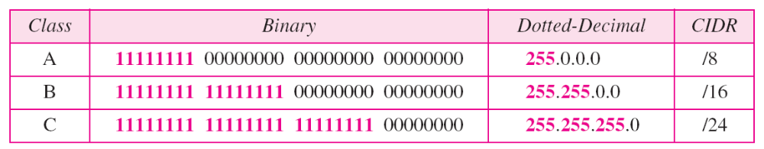
Structure of IPv4 Address
Consists of Net ID and Host ID.
Mask
  32-bit number of contiguous 1’s followed by contiguous 0’s.
  To help to find the net ID and the host ID.

Slide 6
Use of IPv4 Address
Subnetting
  Divide a large address block into smaller sub-groups.
  Use of flexible net mask.
Supernetting
  Exhausted class A and B address space
  Huge demand for class B address space
  To combine several contiguous address spaces into a larger single address space

Slide 7
Classless Addressing
To overcome the depletion of address space.
Restriction
  The addresses in a block must be contiguous.
  The number of addresses in a block must be a power of 2.
  The first address must be evenly divisible by the number of address.
Mask
  Consists of n consecutive 1’s followed by zeros.
  n can be any number b/w 0 and 32.

Slide 8
Classless Addressing
Tips:
  In IPv4 addressing, a block of addresses can be defined as x.y.z.t /n, in which x.y.z.t defines one of the addresses and the /n defines the mask.
  The first address in the block can be found by setting the rightmost 32 − n bits to 0s.
  The last address in the block can be found by setting the rightmost 32 − n bits to 1s.
  The number of addresses in the block can be found by using the formula
  2^{32−n}.

Slide 9
Classful addressing, which is almost obsolete, is replaced with classless addressing.
In IPv4 addressing, a block of
addresses can be defined as
x.y.z.t /n
in which x.y.z.t defines one of the addresses and the /n defines the mask.
The first address in the block can be found by setting the rightmost 32 − n bits to 0s.
The last address in the block can be found by setting the rightmost 32 − n bits to 1s.
The number of addresses in the block can be found by using the formula 2^{32−n}.

Slide 10
Example 1
Figure 1 on next slide shows a block of addresses, in both binary and dotted-decimal notation, granted to a small business that needs 16 addresses.
We can see that the restrictions are applied to this block. The addresses are contiguous. The number of addresses is a power of 2 (16 = 2⁴), and the first address is divisible by 16. The first address, when converted to a decimal number, is 3,440,387,360, which when divided by 16 results in 215,024,210.

Slide 11
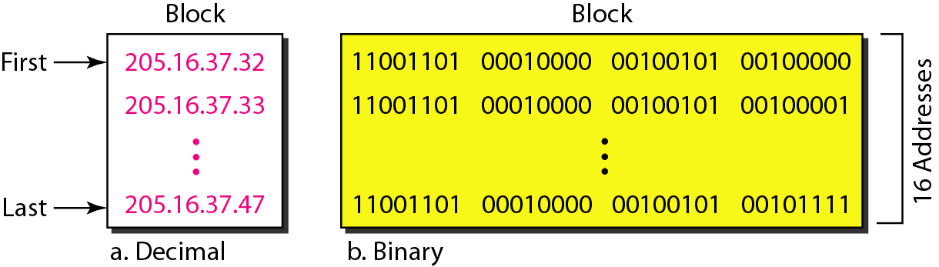
Figure 1 A block of 16 addresses granted to a small organization

Slide 12
Example 2
A block of addresses is granted to a small organization. We know that one of the addresses is 205.16.37.39/28. What is the first address in the block?
Solution
The binary representation of the given address is
11001101 00010000 00100101 00100111
If we set 32−28 rightmost bits to 0, we get
11001101 00010000 00100101 0010000
or
205.16.37.32.
This is actually the block shown in Figure 1 above.

Slide 13
Example 3
Find the last address for the block in Example 2 on previous slide
Solution
The binary representation of the given address is
11001101 00010000 00100101 00100111
If we set 32 − 28 rightmost bits to 1, we get
11001101 00010000 00100101 00101111
or
205.16.37.47
This is actually the block shown in Figure 1 above.

Slide 14
Example 19.8
Find the number of addresses in Example 19.6.
Solution
The value of n is 28, which means that number
of addresses is 2 ³²⁻²⁸ or 16.

Slide 15
Example 19.9
Another way to find the first address, the last address, and the number of addresses is to represent the mask as a 32-bit binary (or 8-digit hexadecimal) number. This is particularly useful when we are writing a program to find these pieces of information. In Example 19.5 the /28 can be represented as
11111111 11111111 11111111 11110000
(twenty-eight 1s and four 0s).
Find
a. The first address
b. The last address
c. The number of addresses.

Slide 16
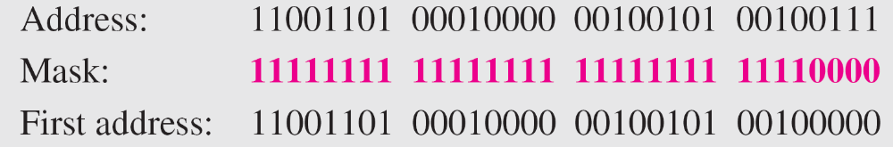
Example 19.9 (continued)
Solution
a. The first address can be found by ANDing the given
addresses with the mask. ANDing here is done bit by
bit. The result of ANDing 2 bits is 1 if both bits are 1s;
the result is 0 otherwise.

Slide 17
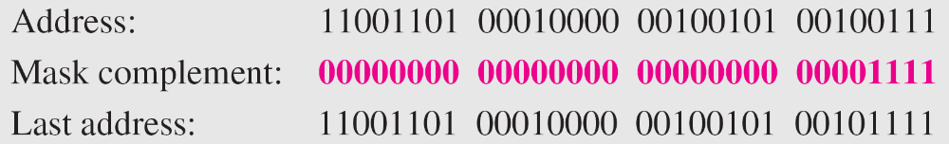
Example 19.9 (continued)
b. The last address can be found by ORing the given
addresses with the complement of the mask. ORing
here is done bit by bit. The result of ORing 2 bits is 0 if
both bits are 0s; the result is 1 otherwise. The
complement of a number is found by changing each 1
to 0 and each 0 to 1.

Slide 18

Note
The first address in a block is
normally not assigned to any device;
it is used as the network address that represents the organization
to the rest of the world.

Slide 19
Thank You
Discussion & Doubt session will be in lecture.
Important terms to keep in mind
  IP Address
  IPv4 Binary and DDN notation
  Classful Addressing

